Slide 1


Java ee
(ADVANCE JAVA)
Lecture-20

Slide 2
Today’s Agenda
Introduction To Session Tracking
Session Tracking Mechanisms
Using Hidden Field

Slide 3
SESSION TRACKING
Http is a stateless protocol .
This means that as soon as the response is generated by the server , the connection gets terminated and the server forgets everything regarding the current request it has served .

Slide 4
SESSION TRACKING
Thus if the same user makes another request then the server will not consider it to be the second request by the client in continuation rather the server will again assume the same client to be a new user.

Slide 5
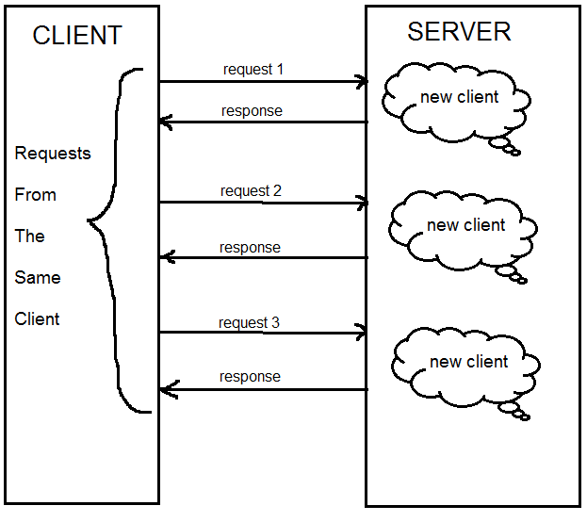
SESSION TRACKING

Slide 6
WHAT IS THE PROBLEM IN BEING STATELESS?
In most of the cases this stateless nature of http will not be a problem.
But there are certain scenario which require that the server should be able to identify the client and associate him with previous request.

Slide 7
EXAMPLES WHERE SESSION TRACKING IS NEEDED
In a shopping cart application a client keeps on adding items into his cart using multiple requests.
Whenever a request is made, the server should identify in which client's cart the item is to be added.
So in this scenario, there is a certain need for session tracking.

Slide 8
EXAMPLES WHERE SESSION TRACKING IS NEEDED
If a user has logged into his Bank Account and after successful login if he wishes to go to the Funds Transfer page then he would be required to login again.
This is because the Funds Transfer would be a login-protected page and the Web Server doesn't have any built-in support for recognizing if the client requesting this page is the one who is already logged in or if it's coming from a new client.

Slide 9
SO , WHAT IS A SESSION?
The term session means the time period the user has spent while navigating a website and if the site keeps track of all his activities then it is called session tracking.
Thus in short we can say the session tracking means creating a log of user activities.

Slide 10
HOW JAVA SUPPORTS SESSION TRACKING ?
Java supports session tracking in 4 ways :
Hidden fields
Query string
Cookies
Java’s session api

Slide 11
HIDDEN FIELDS
Hidden field is a very commonly used technique for session tracking.
A hidden field is almost as good as a normal text field with the only difference that they are not visible to the user.
Moreover they are just like any other input control and if they are set inside the <form> tag then the browser will resend them back to the server when the form is submitted

Slide 12
HIDDEN FIELDS
In this way we will be able to transfer data from one page to another without showing it to the user

Slide 13

SYNTAX

Slide 14
EXERCISE
Write an application which contains two jsp pages called home.jsp and welcome.jsp.
The home.jsp page should ask the user to input his name and when the submit button is clicked it should call welcome.jsp page.
The page welcome.jsp should welcome the user by showing his name and should also display the date and time when the user visited home.jsp

Slide 15
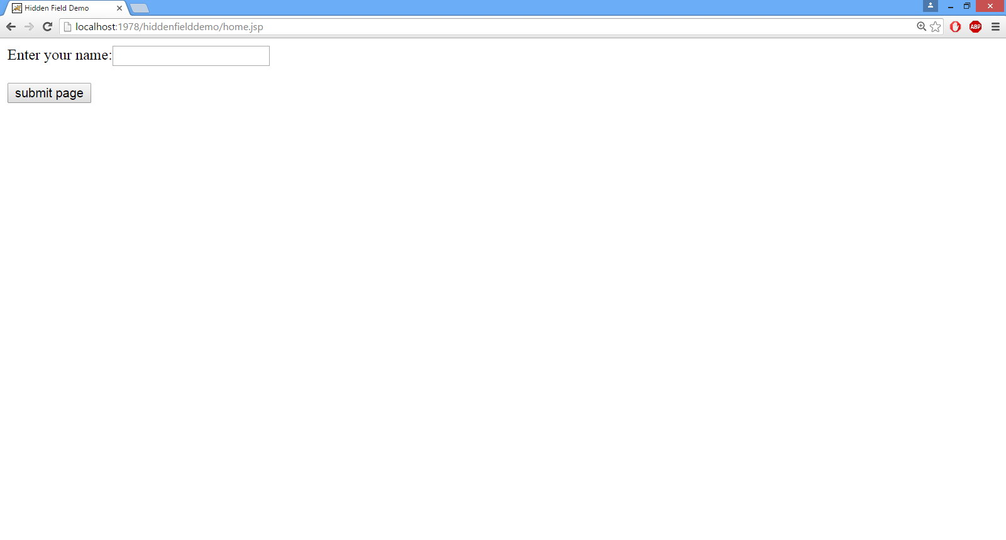
home.jsp

Slide 16
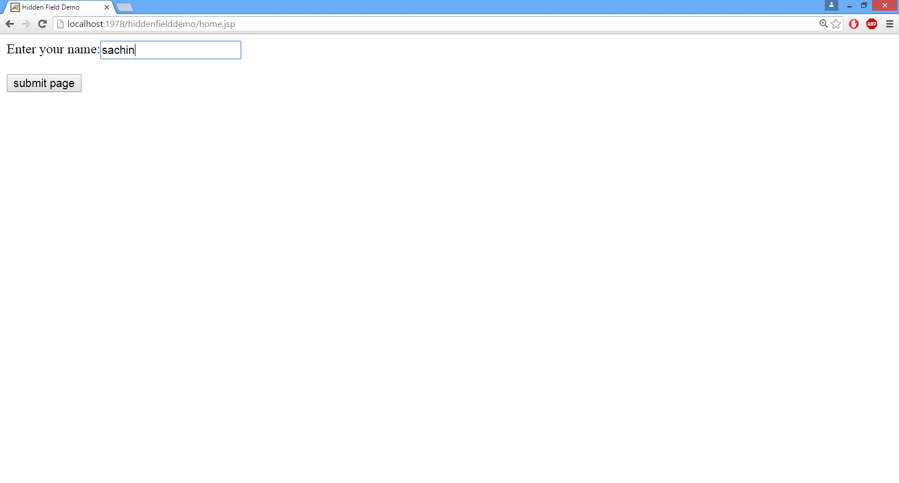
home.jsp

Slide 17
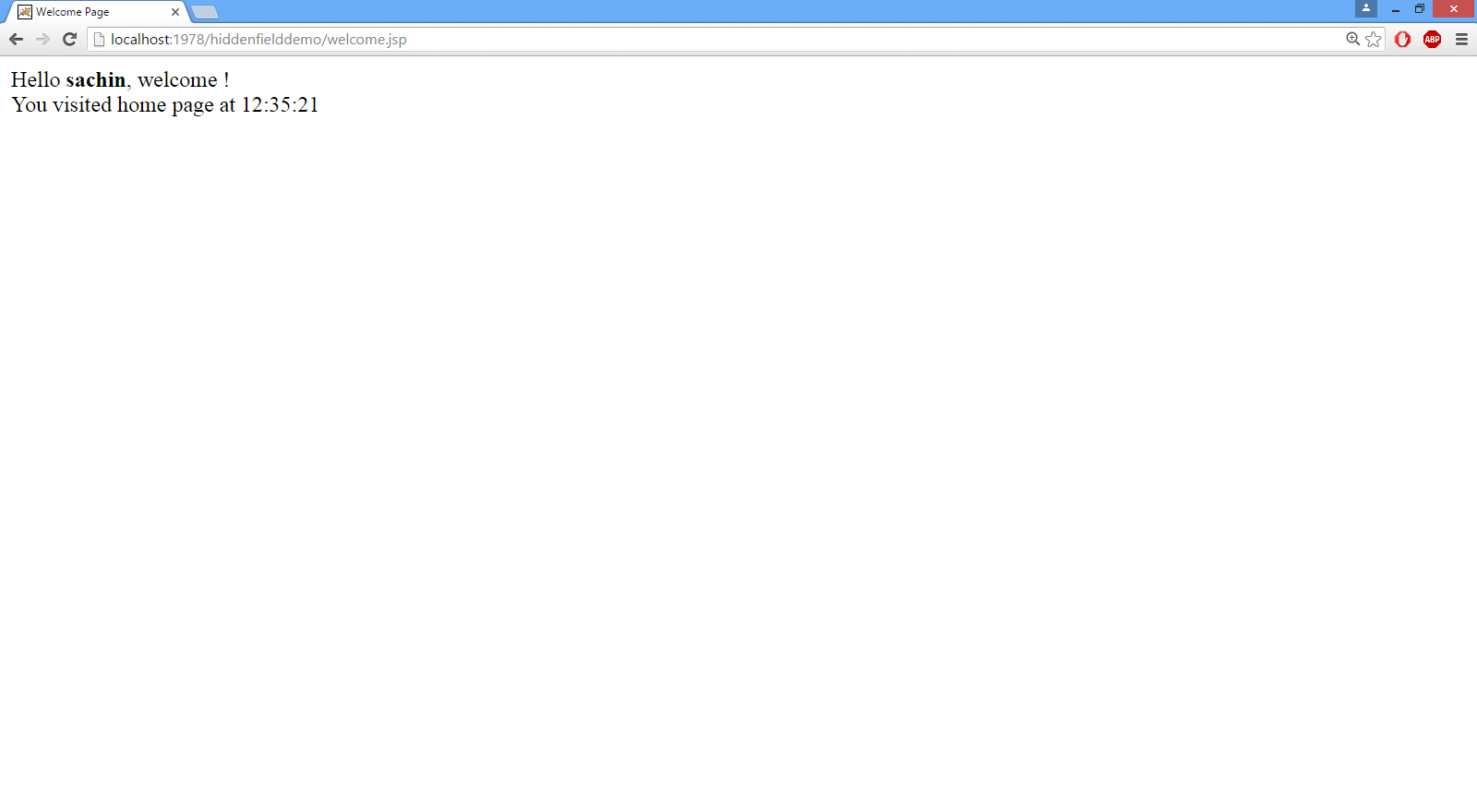
welcome.jsp

Slide 18
SOLUTION (home.jsp)
<html>
<head>
<title>Hidden Field Demo</title>
</head>
<body>
<%
java.util.Date now=new java.util.Date();
java.text.SimpleDateFormat sdf=new java.text.SimpleDateFormat("hh:mm:ss");
String str=sdf.format(now);
%>
<form action="welcome.jsp" method="post">
Enter your name:<input type="text" name="username"><br>
<input type="hidden" name="accesstime"
value="<%= str%>" >
<br>
<input type="submit" value="submit page">
</form>
</body>

Slide 19
SOLUTION (welcome.jsp)
<html>
<head>
<title>Welcome Page</title>
</head>
<body>
Hello <b><%= request.getParameter("username") %></b>,
welcome !<br>
You visited home page at
<%= request.getParameter("accesstime") %>
</body>
</html>

Slide 20
DRAWBACK OF HIDDEN FIELD
User can easily see all the data (maybe some secret info) by looking at the HTML Source of the page.
Makes the page very heavy to be downloaded in the browser.
It only works if every page is dynamically generated

Slide 21

End Of Lecture
For any queries mail us @: scalive4u@gmail.com
Call us @ : 0755-4271659, 7879165533
Agenda for Next Lecture:
Query String
Cookies
Methods Of Cookies

